Slide 1
Comprehensive Digital Marketing
Project Work FabIndia
Presented by : vedula sai vinay vasantha harish
vasupalli charan vankara dinesh vankala rambabu

Slide 2
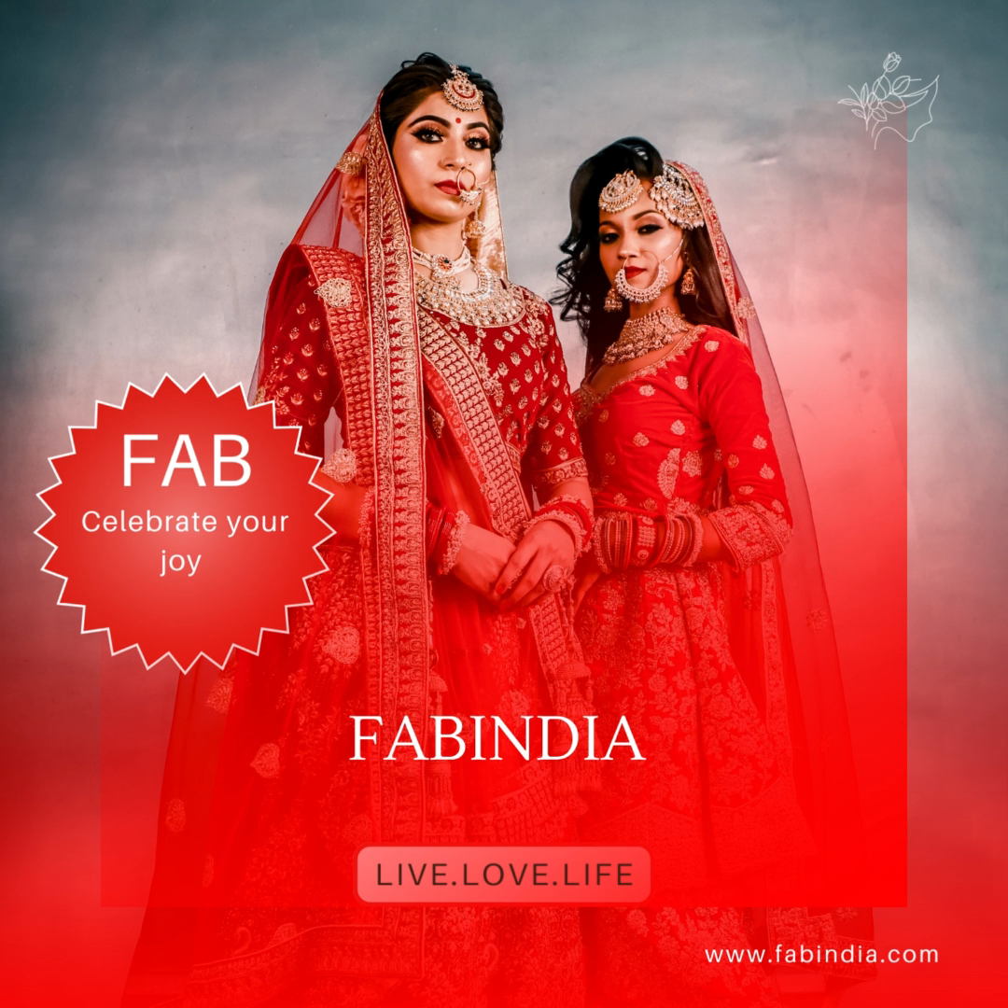

Slide 3
Part 1: Brand study, Competitor Analysis & Buyer’s/Audience’s Persona​
Research Brand Identity: Study the FABINDIA mission, values, vision, and unique selling propositions (USPs).​
Mission/Values:
As of my last update in September 2021, Fabindia is a well-known Indian retail chain that specializes in traditional and handcrafted products. However, there wasn't any specific mission attributed to Fabindia at that time. Instead, the company's philosophy and vision have revolved around promoting traditional Indian crafts and artisans, fostering sustainable rural livelihoods, and celebrating the diversity and heritage of India.

Slide 4
Fabindia's core mission has typically encompassed the following key aspects:
Preserving Indian Craftsmanship: Fabindia aims to preserve and promote traditional Indian craftsmanship and artistry by incorporating handwoven textiles, hand-block printing, hand embroidery, and other traditional techniques into their products. They have played a crucial role in reviving and sustaining various traditional crafts that may have otherwise been on the decline.
Empowering Artisans: The company has been committed to empowering rural artisans and craftsmen by providing them with a sustainable source of income. By working directly with skilled artisans, Fabindia helps them gain access to a larger market, fair wages, and better working conditions.

Slide 5
3.Sustainable and Eco-friendly Practices: Fabindia has been conscious of its environmental impact and has incorporated sustainable and eco-friendly practices in its supply chain whenever possible. This includes using natural dyes, organic materials, and supporting eco-friendly production processes.
4.Promoting Indian Cultural Heritage: Fabindia's products often draw inspiration from India's rich cultural heritage. The company celebrates the diversity of Indian culture by offering a wide range of traditional and contemporary products that reflect the country's various regions and artistic traditions.

Slide 6
USP:
Its unique selling propositions (USPs) lie in several key areas that set it apart from other retailers:
Handmade and Traditional Craftsmanship: FabIndia takes pride in promoting traditional Indian crafts and supporting local artisans and weavers. Their products are handmade and often incorporate techniques such as block printing, handloom weaving, and embroidery, which gives them a unique and authentic appeal.
Ethical and Sustainable Practices: The brand is committed to ethical sourcing and sustainable practices. By supporting local artisans and using natural and eco-friendly materials, FabIndia contributes to the preservation of traditional crafts and helps in reducing the environmental impact.

Slide 7
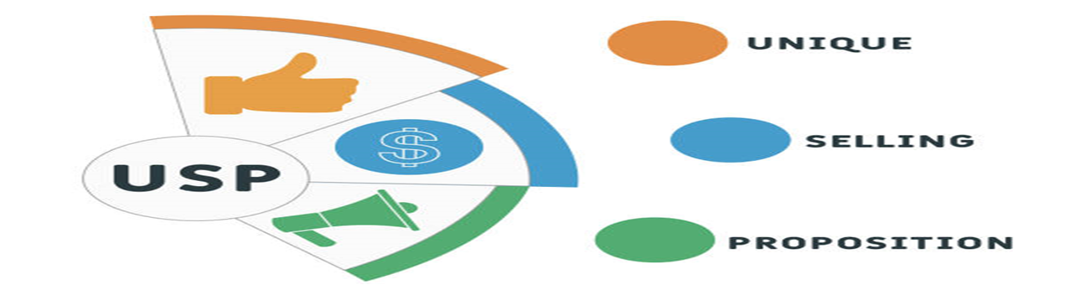
USP DEFINITION

Slide 8
Distinctive Designs: FabIndia's products feature distinctive designs that reflect the rich heritage of India. They blend traditional aesthetics with contemporary styles, making their products attractive to both Indian and international customers.
Wide Product Range: FabIndia offers a wide range of products, including apparel for men, women, and kids, home furnishings, accessories, personal care items, and more. This diverse product range caters to various customer preferences and needs.
Cultural Connection: FabIndia's products often carry a sense of cultural connection, allowing customers to embrace and celebrate Indian traditions and artistry.
Social Impact: Through its business model, FabIndia empowers local artisans and communities, providing them with livelihood opportunities and improving their socio-economic conditions.
Quality Assurance: FabIndia maintains high-quality standards for its products, ensuring customers receive well-crafted and durable items.

Slide 9
Analyze Brand Messaging:
FABINDIA is an Indian retail brand known for its traditional handcrafted products, primarily focusing on clothing, home furnishings, and other lifestyle items. Here are some key aspects of their messaging:
Fabindia Established in 1960 by Jon Bissel, the company is providing employment to more than 30,000 craftsmen and weavers, while promoting traditional artisans and craftsmen of India. Currently, Fab-india has six outlets abroad and 111 outlets in India.
Emphasis on Tradition and Handcraftsmanship: FABINDIA's messaging has consistently revolved around the celebration of Indian traditions and craftsmanship. They highlight the use of traditional techniques and artisanal skills in creating their products, appealing to customers who value authenticity and cultural heritage.

Slide 10
2.Sustainable and Ethical Sourcing: The brand often emphasizes its commitment to sustainable and ethical sourcing practices. By promoting environmentally friendly materials and supporting local artisans, FABINDIA seeks to attract conscious consumers who are mindful of the social and environmental impact of their purchases.
3.Unique and Exclusive Collections: FABINDIA positions its products as unique and exclusive, often using phrases like "handpicked," "limited edition," or "one-of-a-kind" to create a sense of rarity and desirability. This messaging aims to establish a premium perception of their offerings.
4.Indian Contemporary Style: While FABINDIA celebrates traditional Indian craftsmanship, it also incorporates contemporary design elements to appeal to a broader audience, including younger generations. This blend of tradition and modernity may be reflected in their messaging to showcase the brand's versatility and relevance.

Slide 11
Some of the most effective Fabindia tagline slogans in Market:
Go ethnic, go Fabindia.
Ethnic meets modern with Fabindia.
Explore a world of ethnic fashion with Fabindia
Embrace your heritage with Fabindia.
Live the Fabindia lifestyle
From India, with love – Fabindia.
Celebrate diversity with Fabindia.
Refresh your style with Fabindia.

Slide 12
Anokhi:
Anokhi is another competitor known for its hand-block printed textiles and clothing. They emphasize the use of natural dyes and traditional printing techniques to create unique and vibrant designs. Anokhi has a significant presence in both physical stores and online platforms. Their designs appeal to individuals who appreciate traditional Indian prints and patterns with a focus on sustainable and eco-friendly practices.
2.Good Earth:
Good Earth is a high-end competitor that offers luxury home furnishings, decor, and clothing inspired by Indian culture and heritage. Their products are often exquisitely crafted and cater to a more affluent clientele. Good Earth has an exclusive appeal due to its premium pricing and exquisite design aesthetics, attracting customers looking for luxury products with an Indian touch.

Slide 13
Competitor Analysis:
As of my last update in September 2021, Fabindia is an Indian retail company known for its wide range of traditional and handcrafted products, including clothing, home furnishings, and accessories. To conduct a competitor analysis of Fabindia, I will consider three potential competitors in the Indian retail market. However, please note that the competitive landscape may have changed after my last update, so it's essential to verify this information with more recent sources.
Jaypore:
Jaypore is a competitor that offers a similar range of traditional and handcrafted products, including apparel, home decor, and accessories.
2. Tjori:
Tjori is made in india brand for the modern Indian sensibilities.
3.Anokhi:
founded in 1970,anokhi ethos is rooted in craft conservation and development through design and project funding.

Slide 14
Buyer's/Audience's Persona:
​
The brand's target audience typically includes:
Ethical and Conscious Consumers: Fabindia appeals to consumers who prioritize ethical and sustainable practices. The brand's focus on promoting traditional crafts and supporting rural artisans resonates with individuals who are conscious about the environmental and social impact of their purchases.
Art and Craft Enthusiasts: Fabindia's products are known for their artisanal craftsmanship and unique designs. Art and craft enthusiasts, who appreciate the intricacy and beauty of handcrafted items, form a significant part of Fabindia's target audience.
Cultural and Heritage Seekers: Fabindia celebrates India's rich cultural heritage by incorporating traditional techniques and motifs in its products. Individuals interested in exploring and preserving India's diverse cultural heritage are likely to be attracted to Fabindia's offerings.

Slide 15
4.Fashion-Forward Consumers: Fabindia offers a blend of traditional craftsmanship and contemporary designs. Fashion-conscious individuals who seek to stand out with unique and stylish apparel and accessories may be drawn to Fabindia's products.
5.Home Decor and Interior Enthusiasts: Fabindia's home furnishings and decor items, such as furniture, textiles, and decorative pieces, cater to individuals who are passionate about creating aesthetically pleasing and culturally inspired living spaces.
6.Tourists and Souvenir Shoppers: Fabindia stores, particularly in tourist destinations, often attract travelers looking for authentic Indian souvenirs and gifts that reflect the country's cultural essence.

Slide 16
Demographics, psychographics, behaviors, and interests of Fabindia's target audience can vary across different regions and markets. However, here is a general overview of the characteristics that may be associated with Fabindia's typical customers:
Demographics:
Age: Fabindia attracts a wide range of age groups, from young adults to middle-aged and older consumers. However, the majority of their customers are likely to be in the 25-45 age bracket.
Gender: Fabindia caters to both men and women, offering a diverse range of products for each gender.
Income Level: Fabindia's products are often priced at a premium due to their focus on craftsmanship and quality. As a result, their target audience is likely to consist of middle to upper-middle-income individuals.

Slide 17
Psychographics:
Ethical and Sustainable Values: Fabindia appeals to individuals who value ethical and sustainable practices. Customers are likely to be conscious of the environmental and social impact of their purchases and prefer products that support local artisans and traditional crafts.
Cultural Appreciation: The brand attracts people who appreciate and celebrate India's diverse cultural heritage. Fabindia's products often reflect regional aesthetics and traditional motifs, resonating with those interested in cultural exploration.
Style and Individuality: Fabindia's customers are often fashion-forward individuals who seek unique and distinctive clothing and accessories. They appreciate the fusion of traditional craftsmanship with contemporary designs, allowing them to express their individuality.

Slide 18
Behaviors:
Repeat Customers: Fabindia's loyal customer base tends to be made up of repeat buyers who appreciate the brand's consistent quality and support for traditional crafts.
Occasional Splurge: Some Fabindia customers may treat themselves to occasional splurges on special occasions or when they want to invest in high-quality, handcrafted items.
In-Store Experience: Fabindia's brick-and-mortar stores offer a pleasant and immersive shopping experience. Customers may enjoy browsing through the artisanal products and experiencing the tactile aspect of the merchandise.
Interests:
Handcrafted Products: Fabindia attracts individuals interested in handcrafted goods, whether it's clothing, accessories, or home decor items.
Art and Design: Customers who have an interest in art, design, and traditional crafts are likely to be drawn to Fabindia's offerings.
Home Decor and Furnishings: Individuals looking to add an ethnic touch to their homes may explore Fabindia's collection of home decor and furnishings.

Slide 19

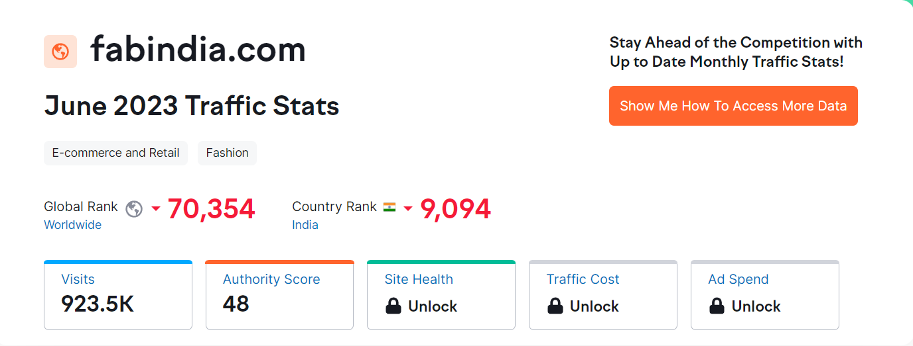
Part 2: SEO & Keyword Research

Slide 20
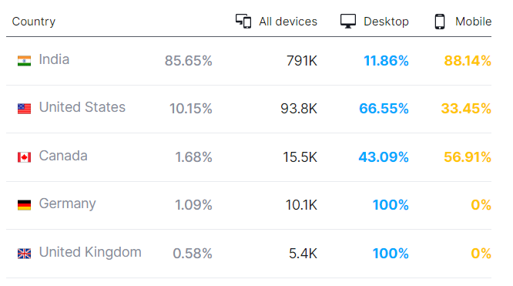
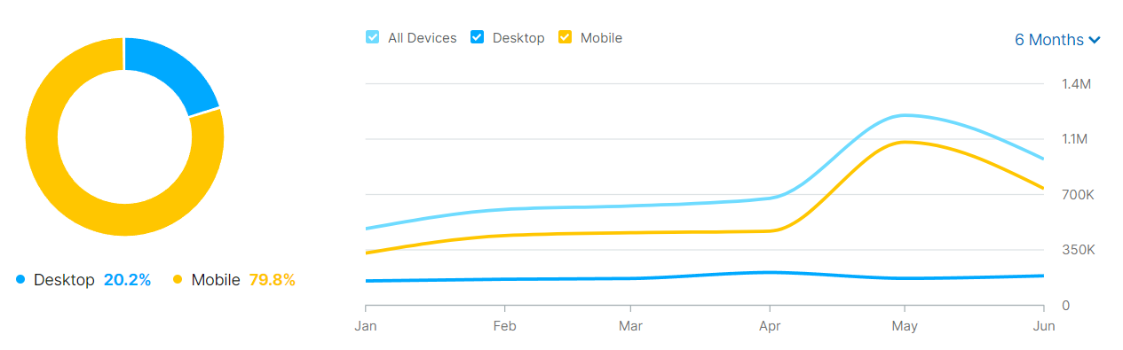
fabindia.com Website Traffic by Country and fabindia.com Traffic Share by Device

Slide 21
Keyword Research:
1. Define Research Objectives: Before starting keyword research, it's essential to understand the specific goals of the research. In the case of Fabindia, the research objectives might be:
Improve organic search traffic to the Fabindia website.
Identify high-converting keywords related to Fabindia's products.
2. Brainstorm Seed Keywords: Begin by brainstorming a list of seed keywords that are directly related to Fabindia's products, services, and industry. These could include terms like:
Fabindia
Ethnic wear
Handmade clothing
Indian traditional fashion
Sustainable fashion, etc.

Slide 22
3. Utilize Keyword Research Tools: To expand your list of keywords and get valuable insights, use keyword research tools like SEMrush or Moz Keyword Explorer. Enter your seed keywords, and these tools will provide you with a comprehensive list of related keywords, search volume, competition, and other data.
What are Semrush and Moz?
Simply put, Semrush and Moz are tools that give you information — SEO data that you can use to optimize your website for search engines.
4. Analyze Competitor Keywords: Analyze the top competitors in Fabindia's industry to discover which keywords they are ranking for. This can provide valuable insights into high-performing keywords and content gaps. Tools like SEMrush and Moz can help you identify the keywords that competitors are targeting.

Slide 23
5. Long-tail Keyword Exploration: Long-tail keywords are specific, longer phrases that users often search for when they are closer to making a purchase decision. These keywords typically have lower competition but higher conversion potential. For Fabindia, some examples of long-tail keywords could be:
"Handmade cotton sarees for weddings"
"Ethnic Kurtis for summer fashion"
"Sustainable Indian fashion brands"
"Handcrafted home decor from India"
"Buy Fabindia products online," etc.
6. Assess Competition and Conversion Potential: When selecting keywords, consider the balance between search volume and competition. Focus on keywords with a reasonable search volume and relatively lower competition. Additionally, prioritize keywords that align with the research objectives and have a higher likelihood of driving conversions for Fabindia.

Slide 24
On page Optimization:
Meta tag optimization and content optimization are essential aspects of on-page SEO that can help improve a website's visibility and relevance in search engine results. Here's a guide on how to perform meta tag and content optimization for Fabindia:
Meta Tag Optimization:
Title Tags:
Ensure each page has a unique and descriptive title tag (60-70 characters) that includes relevant keywords and accurately reflects the page's content.
Incorporate the brand name, if appropriate, to enhance brand visibility in search results.
Avoid keyword stuffing and create titles that are appealing to users and encourage clicks.

Slide 25
2.Meta Descriptions:
Craft compelling meta descriptions (up to 160 characters) for each page to entice users to click through from the search results.
Use relevant keywords naturally, but make sure the description reads well and provides a clear idea of what the page offers.
Avoid duplicate meta descriptions across different pages.
3.URL Structure:
Ensure the URLs are clean, descriptive, and include relevant keywords, but keep them concise and easy to read.
Avoid using dynamic parameters in URLs, if possible, and use hyphens to separate words.

Slide 26
Content Optimization:
Keyword Research:
Perform keyword research to identify relevant and high-traffic keywords related to Fabindia's products and services.
Use tools like SEMrush or Moz Keyword Explorer to find popular and relevant keywords to target in your content.
2.High-Quality Content:
Create valuable, informative, and engaging content that addresses the needs and interests of the target audience.
Use clear and concise language, and ensure the content is well-organized with proper headings, subheadings, and paragraphs.
3.Keyword Usage:
Incorporate the targeted keywords naturally throughout the content, including in the title, headings, and body.
Avoid keyword stuffing, which can lead to a negative impact on search rankings.

Slide 27
4.Semantic SEO:
Use related keywords and synonyms to enhance the content's context and relevance to search engines.
Google's algorithm is increasingly focused on understanding the meaning of content, so using semantic variations can be beneficial.
5.Image Optimization:
Optimize image alt tags with descriptive and relevant keywords to improve accessibility and image search visibility.
6.Internal Linking:
Implement internal linking to guide users to related content within the site.
Internal links also help search engines understand the structure and hierarchy of your website.

Slide 28
Part 3: Content Ideas and Marketing Strategies
Content Ideas for Fabindia:
Product Showcases: Create visually appealing and informative content that showcases Fabindia's unique products, such as ethnic wear, home decor, and handcrafted items. Highlight the craftsmanship, materials used, and the story behind each product.
Sustainable Fashion: Educate the audience about Fabindia's commitment to sustainability and ethical practices in the fashion industry. Share stories about the artisans and their traditional techniques used to create eco-friendly products.
Fashion Guides: Produce fashion guides and styling tips using Fabindia's products. For example, "5 Ways to Style a Handwoven Saree" or "Ethnic Wear Trends for Festive Season."
Behind-the-Scenes: Offer a behind-the-scenes look at Fabindia's workshops and the creative process behind their products. This could include videos or photo essays showcasing artisans at work.

Slide 29
5.DIY and Home Decor Ideas: Provide DIY ideas using Fabindia's home decor products to inspire customers to incorporate these items into their living spaces.
6.Seasonal Collections: Introduce and promote Fabindia's seasonal collections, tying them to festivals, celebrations, or current fashion trends.
7.Lifestyle Blog: Start a blog that covers various aspects of Indian lifestyle, including fashion, home decor, travel, wellness, and food. Position Fabindia as a go-to resource for all things related to Indian culture and aesthetics.
8.Customer Stories: Share customer testimonials and stories about their experiences with Fabindia products. User-generated content can also be utilized to showcase how customers style and use Fabindia products in their daily lives.
9.Local Culture and Traditions: Create content that celebrates the rich cultural heritage of India and the traditional crafts and art forms that inspire Fabindia's designs.

Slide 30

Create a content calendar for the month of July by brainstorming content themes
A content calendar is an easy way to combat this issue and to make the most of your company’s scarce resources. It is an effective tool for coordinating content creation and helps divide your team’s upcoming workload into clear, easily-manageable units.
By implementing this tool to your planning process, you will have to spend less time on wondering what to write, and instead focus on the creation itself. We gathered 10 tips to help you get you started in creating your own content calendar:
1. Define your goals
2. Create a template for the calendar
3. Choose your channels
4. Start with the calendar year
5. Add your own content
6. Keep evergreen content at hand
7. Make use of prior content
8. Decide on the publishing frequency and set time limits
9. Update and review your plan
10. Monitor how your content is received

Slide 31


Slide 32
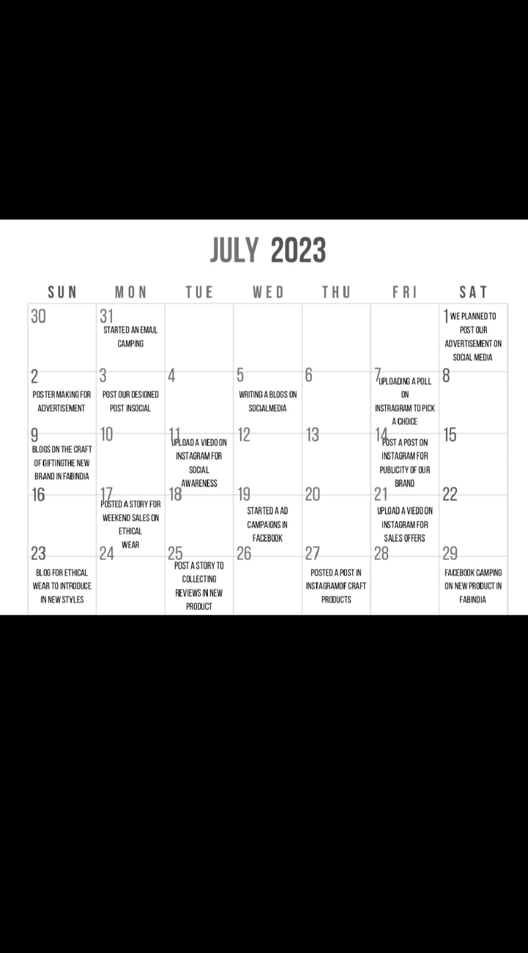
Content calendar for the month of July

Slide 33
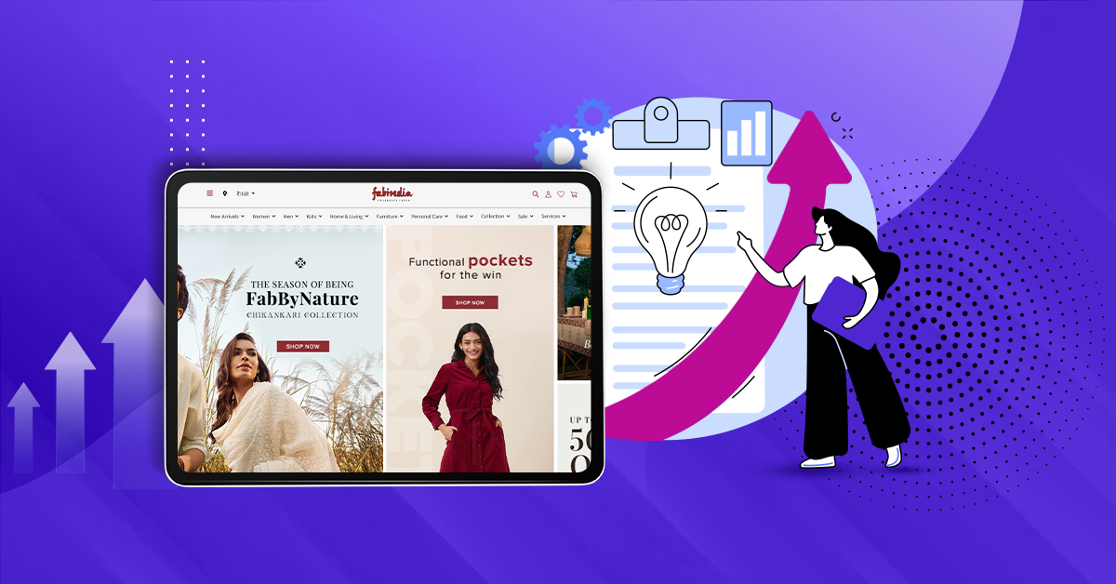
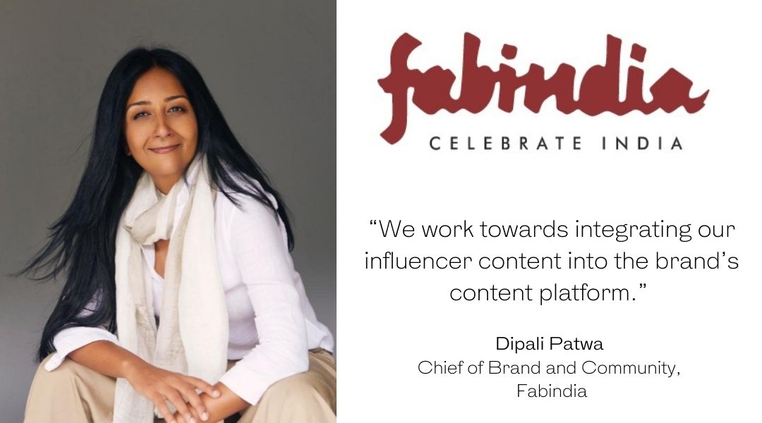
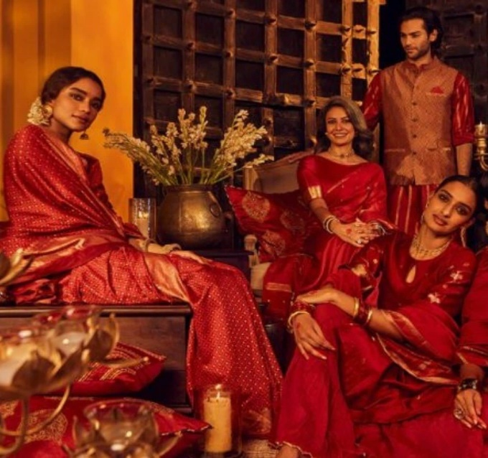
Month of July by brainstorming content themes and Blog posts

Slide 34
Marketing Strategies for Fabindia:
Social Media Campaigns: Leverage platforms like Instagram, Facebook, and Pinterest to visually showcase Fabindia's products, lifestyle, and sustainable practices. Engage with the audience through contests, polls, and user-generated content campaigns.
Influencer Partnerships: Collaborate with influencers who align with Fabindia's brand values and have a significant following among the target audience. Let them create content featuring Fabindia products and share it with their followers.
Email Marketing: Implement personalized email campaigns to keep customers informed about new collections, promotions, and exclusive offers.
Content Marketing: Develop a content marketing strategy that includes blog posts, articles, videos, and infographics to drive organic traffic and showcase Fabindia's expertise in Indian culture and sustainable fashion.
SEO and SEM: Optimize the website and content for search engines to increase organic visibility. Consider running paid search campaigns to target specific keywords and drive traffic during promotional periods.

Slide 35
6.Collaborations and Partnerships: Collaborate with like-minded brands, NGOs, or influencers to co-create content or limited-edition products that align with Fabindia's values
.
7.Offline Events: Host events or pop-up shops in key locations to increase brand visibility and engage with potential customers directly.
8.CSR Initiatives: Promote Fabindia's corporate social responsibility initiatives, such as supporting artisans and promoting sustainable practices, to create a positive brand image.
9.Referral Program: Encourage existing customers to refer Fabindia to their friends and family by offering incentives such as discounts or loyalty rewards.
10.In-Store Experience: Ensure a delightful in-store experience by offering personalized assistance, workshops, or events related to Indian crafts and traditions.

Slide 36
Part 4: Content Creation and Curation (Post creations, Designs/Video Editing, Ad Campaigns over Social Media and Email Ideation and Creation) ​
Many tiny fashion brands worldwide are now widely publishing on Instagram with no restrictions.
Instagram is a platform where brands can use post reels and stories to market their products, attract traffic back to their websites, and eventually drive sales.
Whether in the form of images or illustrations, visual content has always been important to the fashion business.
However, the fashion sector is increasingly using video as a marketing tool, allowing companies to connect with offline and online clients.

Slide 37
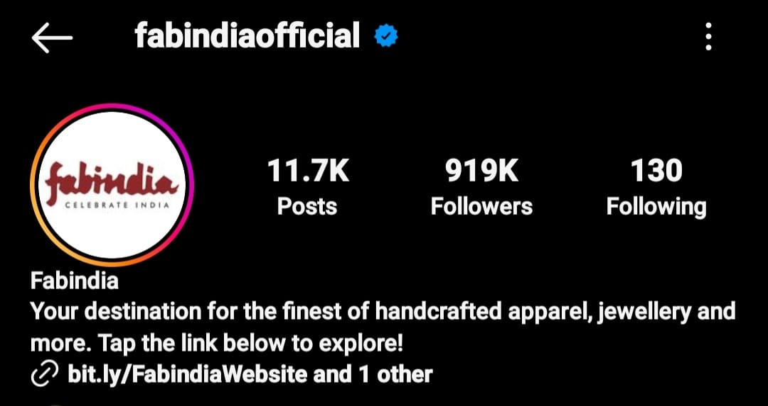
Many brands have recognised the significance of Instagram and are starting to incorporate it into their overall strategy, and one of them is currently succeeding in the fashion industry. Let's look at how Fabindia used its social media marketing team to give Instagram marketing its best effort

Slide 38
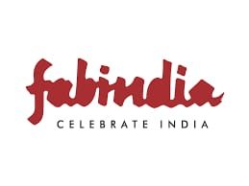
Part 4: Content Creation and Curation (Post creations, Designs/Video Editing, Ad Campaigns over Social Media and Email Ideation and Creation)
https://www.instagram.com/p/Cqpi5CiJBNv/?igshid=MTc4MmM1YmI2Ng==
Post Creation:
Topic: Brand Awareness and Products

Slide 39
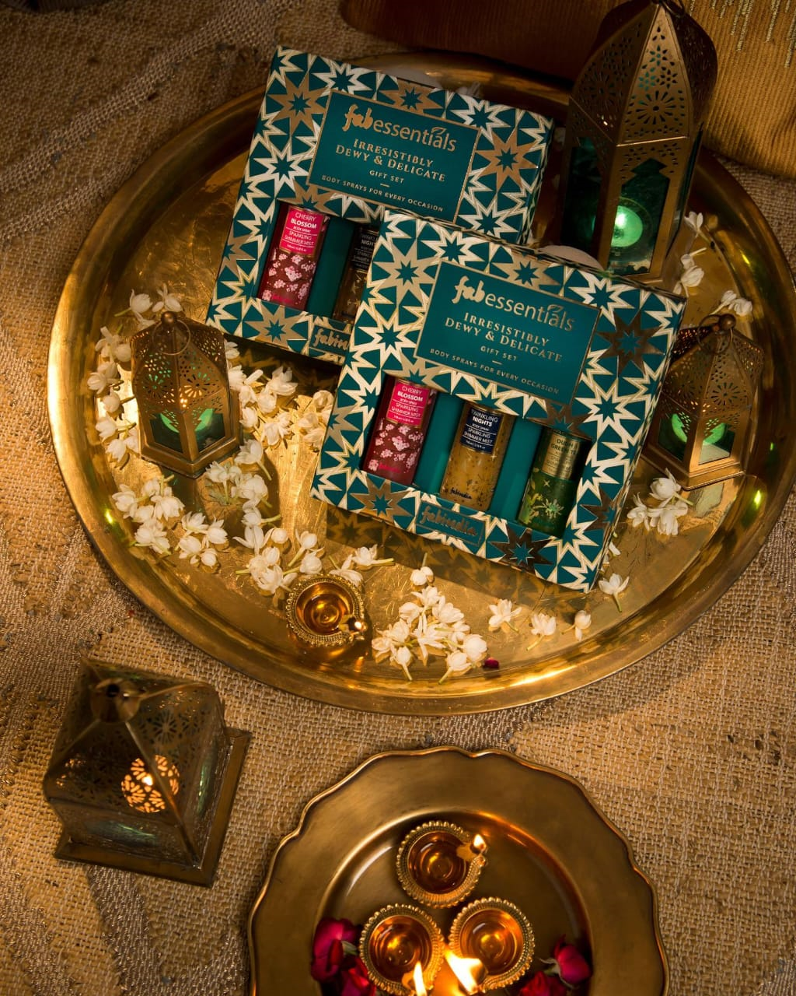
Part 4: Content Creation and Curation (Post creations, Designs/Video Editing, Ad Campaigns over Social Media and Email Ideation and Creation)
Topic : Brand New Product

Slide 40
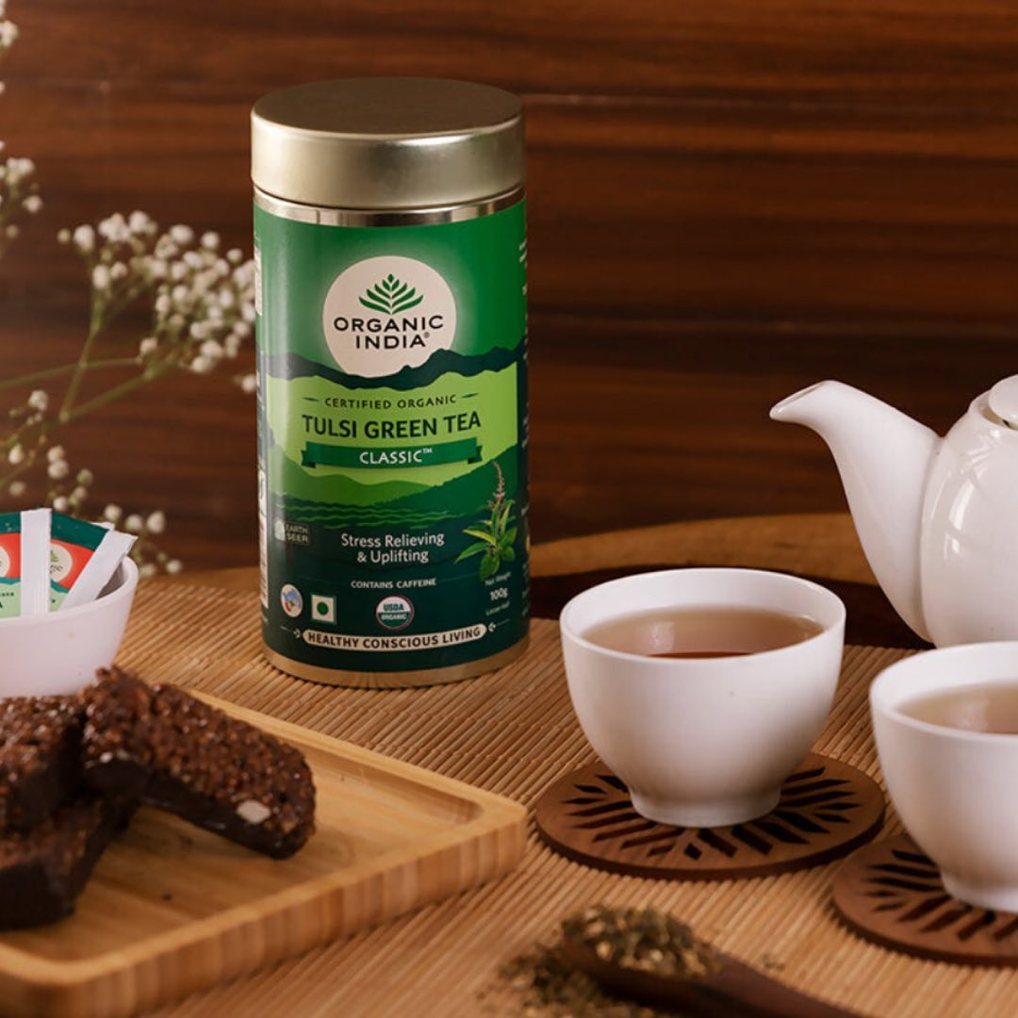
Part 4: Content Creation and Curation (Post creations, Designs/Video Editing, Ad Campaigns over Social Media and Email Ideation and Creation)
Topic : For the Intrest of Audience

Slide 41
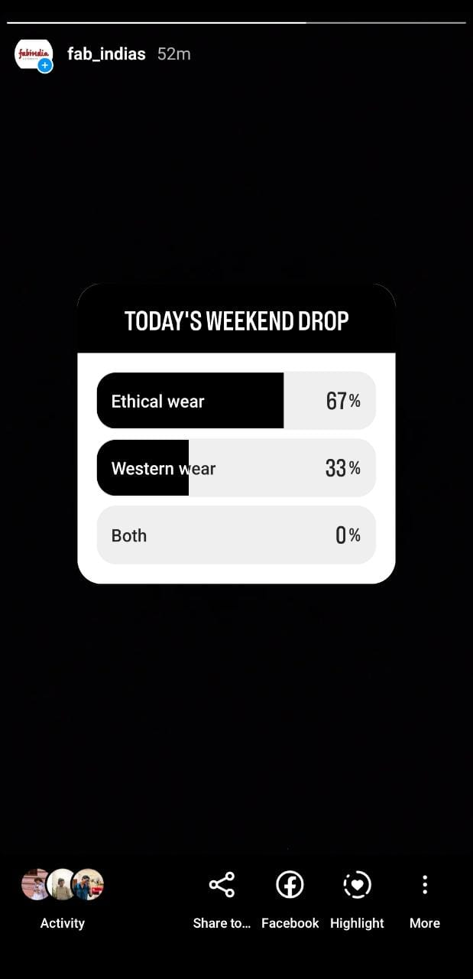
Part 4: Content Creation and Curation (Post creations, Designs/Video Editing, Ad Campaigns over Social Media and Email Ideation and Creation)
STORY: Weekend Drop Ethical Wear VS Western Wear

Slide 42
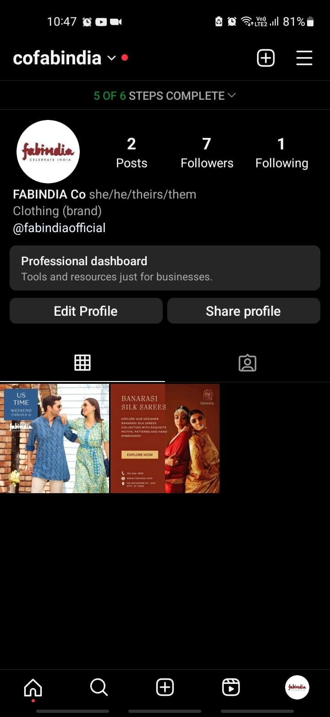
Part 4: Content Creation and Curation (Post creations, Designs/Video Editing, Ad Campaigns over Social Media and Email Ideation and Creation)
Instagram:https://www.instagram.com/p/Cqpi5CiJBNv/?igshid=MTc4MmM1YmI2Ng==

Slide 43
» Fabindia targets ads based on the type of clothing the viewer is interested in or has recently purchased. Fabindia also targets ads based on gender.
>> Clothing, footwear, luggage, and eyewear are among the products they deal with. Alok intends to promote its products even further with the establishment of its YouTube channel and Facebook page.
» Fabindia uses social media to promote its clothing. They have more than 157,000 likes on their Facebook page and over 7.4k subscribers on their YouTube channel.
» Fabindia Tailors targets those in Asia, who are looking to have their suits tailored to fit them perfectly. This is thanks to their mobile app and SMS, which allows users to take their measurements without visiting the tailors in person.

Slide 44

Part 4: Content Creation and Curation (Post creations, Designs/Video Editing, Ad Campaigns over Social Media and Email Ideation and Creation)
Designs
// Explore a world of ethnic fashion with Fabindia

Slide 45
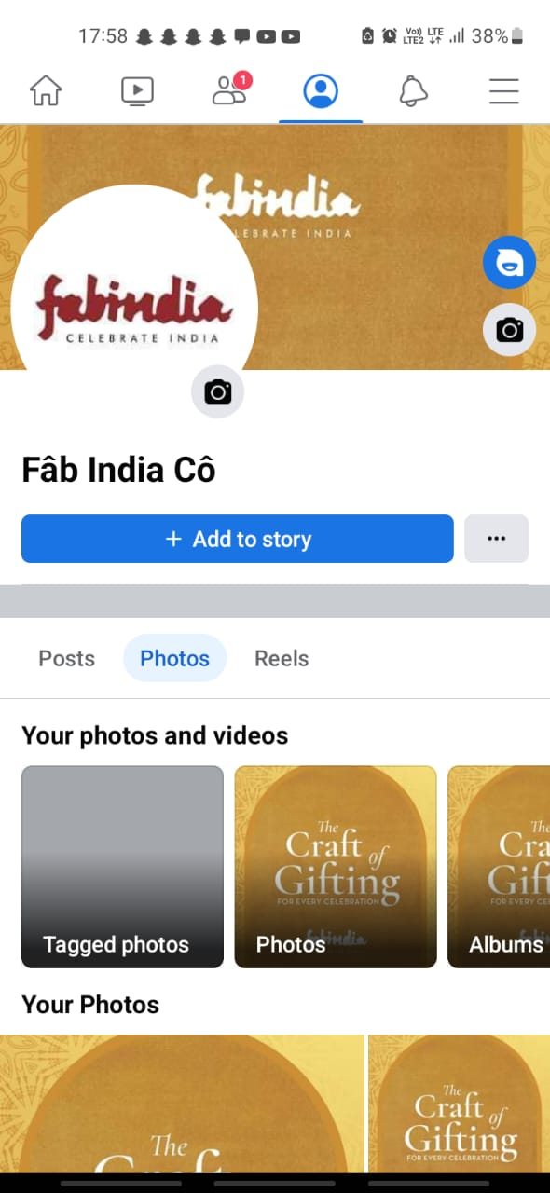
Facebook Strategies of Fabindia Story
Facebook's tools cater to the business that wants to form an authentic relationship with their audience. It allows marketers to create and distribute quality content that's helpful for users. And it allows sales and customer services reps to connect with consumers interested in a brand. Facebook's strategy is rapid growth, driven by multi-sided platform network effects, user monetization through advertisement and acquisition of adjacent competitors to remain the social media titan
https://www.facebook.com/profile.php?id=61550034844616&mibextid=ZbWKwL

Slide 46
» Fabindia has increased its sales by 82% and in-store traffic by 28% since implementing Lead Ads. This can be attributed to the company's improved marketing efforts that have targeted the right people.
Success Formulae of Fabindia
Fabindia takes great pride in manufacturing most garments, shoes, and accessories.
The Success Formulae of Fabindia are
1. Great digital marketing strategy.
2. There are shops all around the nation
3. Improved inbound and outbound marketing strategies.

Slide 47


Slide 48


FABINDIAC@GMAIL.COM

Slide 49


Slide 50


